Slide 1
Teaching languages in the digital era
PALERMO - ITALY

Slide 2
Venue

Slide 3
Morning session started at 8 o’clock everyday with the warmup activities

Slide 4
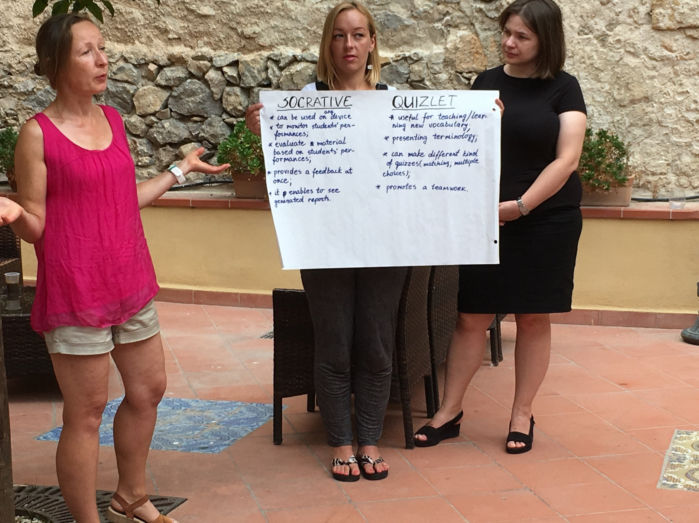
Analysing, summing up and presenting the things that we had learned the day before was our main task.

Slide 5
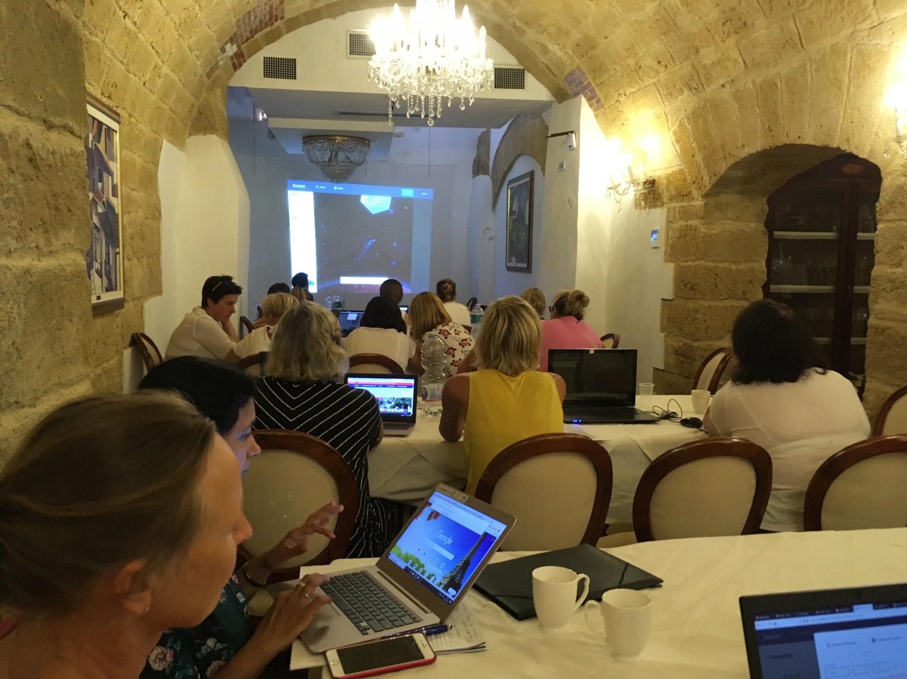
Our project coordinator taught us different IT applications everyday and then we had to test pilot them either in groups or individually.

Slide 6
Proper guidance or assistance were provided to us from time to time.

Slide 7
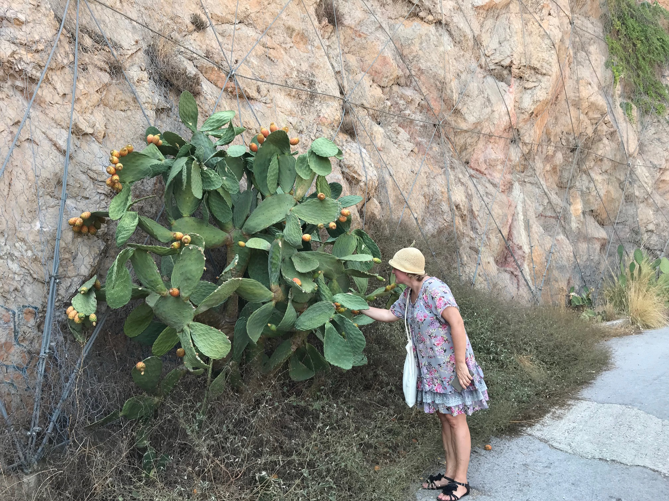
Excursions were yet another interesting part of the project. (My colleague from Estonia inspecting the type of fruit grown on cactus plants).

Slide 8
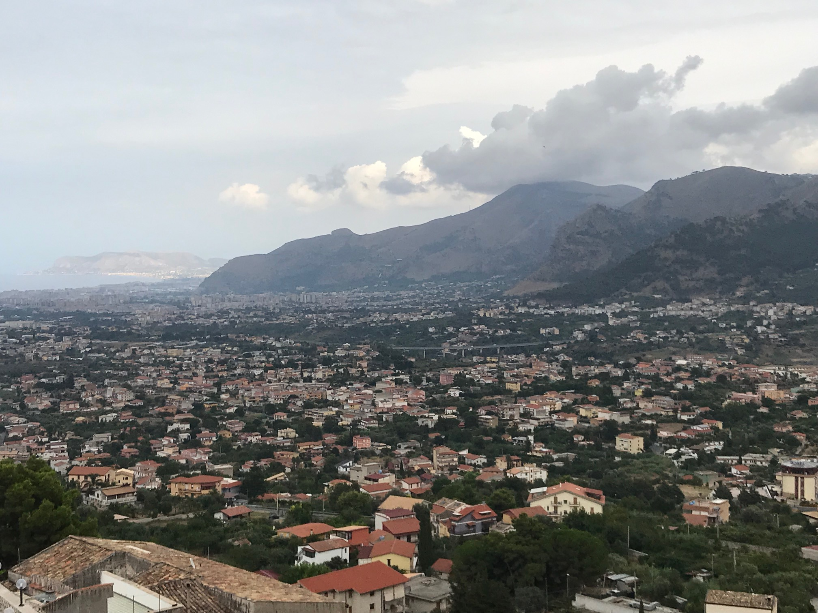
PALERMO city (Royal castle)
From the top of the cathedral

Slide 9
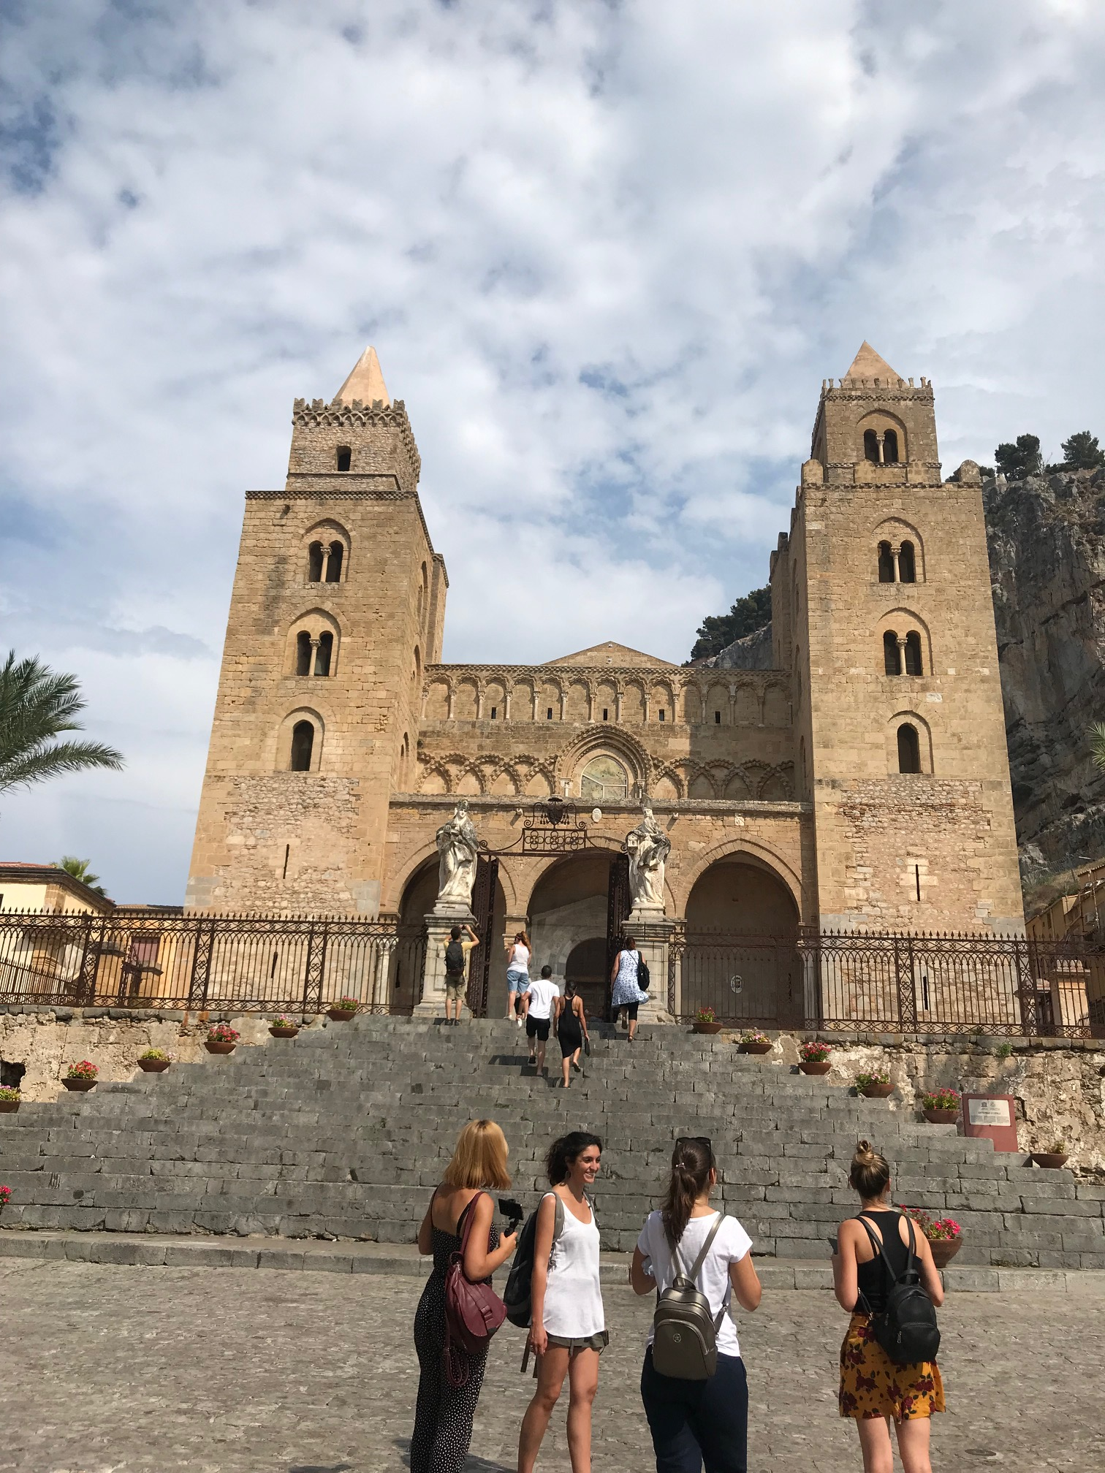
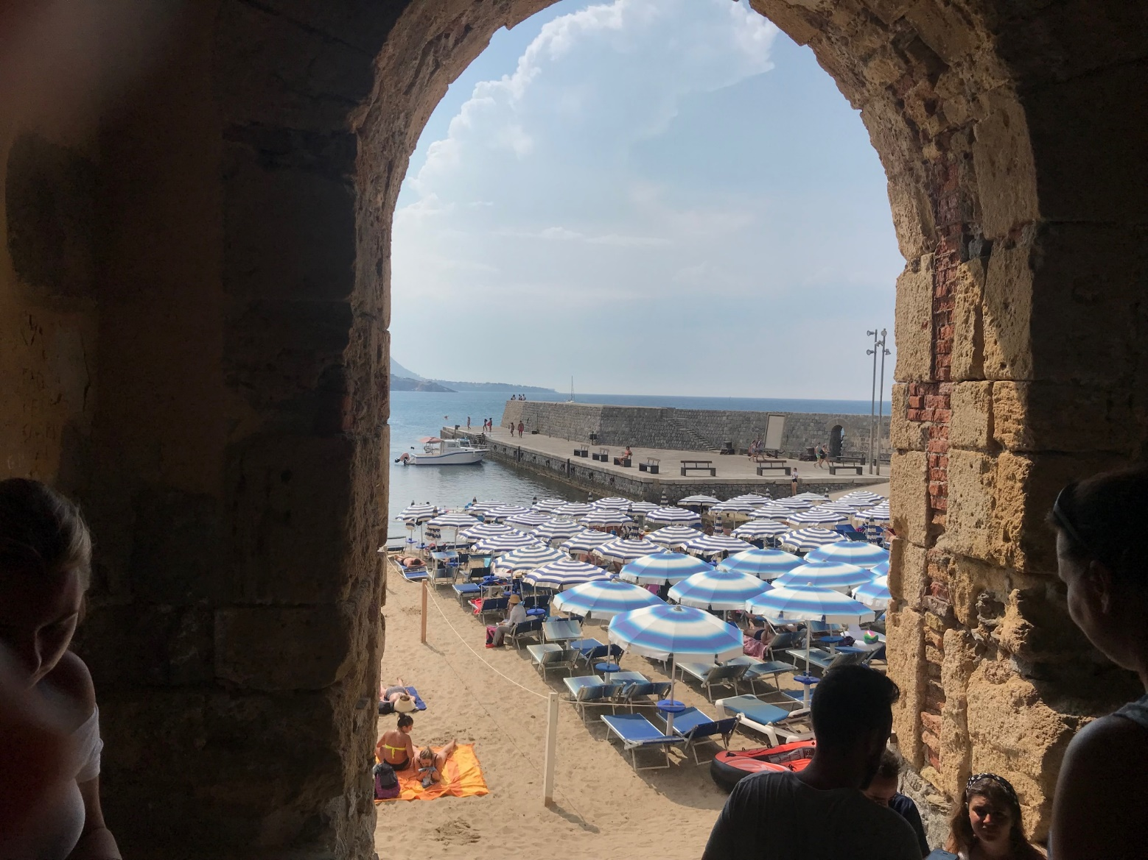
Cefalu

Slide 10
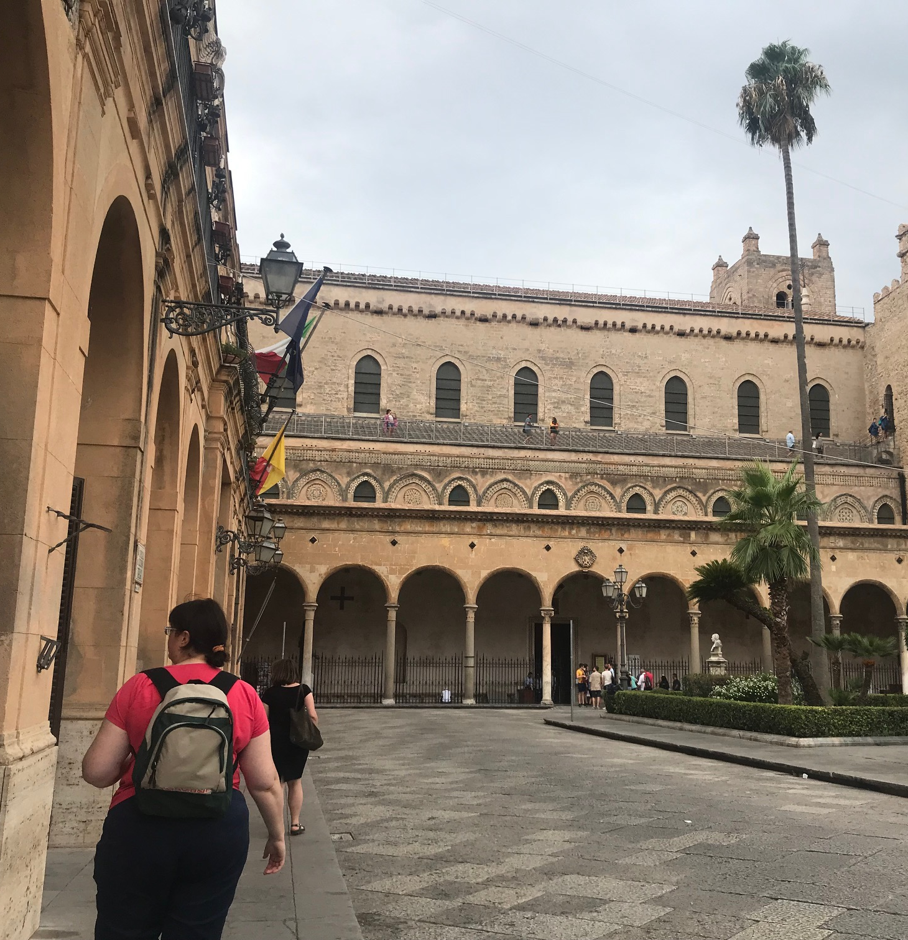
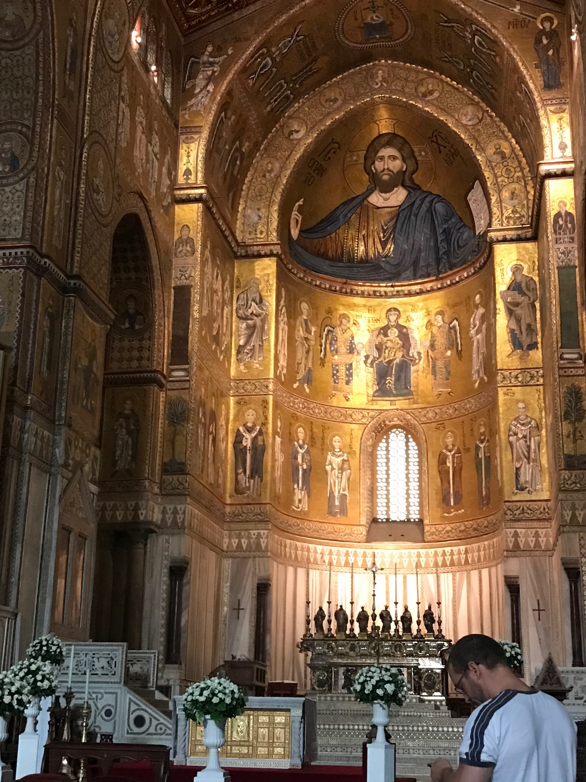
Cattedrale di Monreale

Slide 11
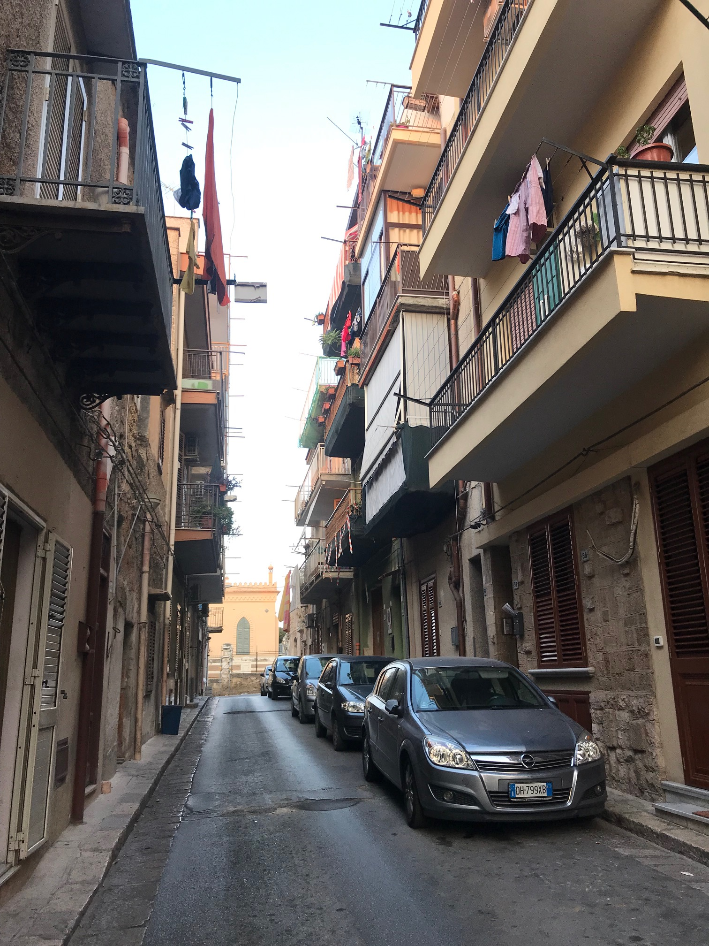
Our hotel and surrounding residential area (BAGHERIA)

Slide 12
Completion of the course certificates

Slide 13
Apps, websites or links
Kahoot and Mentimeter
Quizlet (quizlet-live)
Socrative
Learningapps.org
Powtoon
Edpuzzle
Explain everything
Edmodo
Weebly
PhotoGrid
Snapseed
Magisto

